Slide 1
Applicant Visit Day
Getting to grips with code!
Prof Yannis Korkontzelos
Material preparation: Dr. Robert Lyon
Notes:
Activities files also available in Github at: https://github.com/yannisKork/ProgrammingTasterEHU

Slide 2
Welcome
Welcome to the virtual applicant visit day!
This session aims to introduce you to computer programming, giving you an idea of the type of work you’ll do as a first year undergraduate studying here.
The session aims to:
Help you understand the importance of coding.
Help you understand how coding relates to our degree programmes.
Introduce some basic coding terminology.
Give you the opportunity to solve some coding challenges for yourself.
We have only 1 hour, but I encourage you to take up independent study after the session, whether you join us here or not. It pays to get a head start!

Slide 3
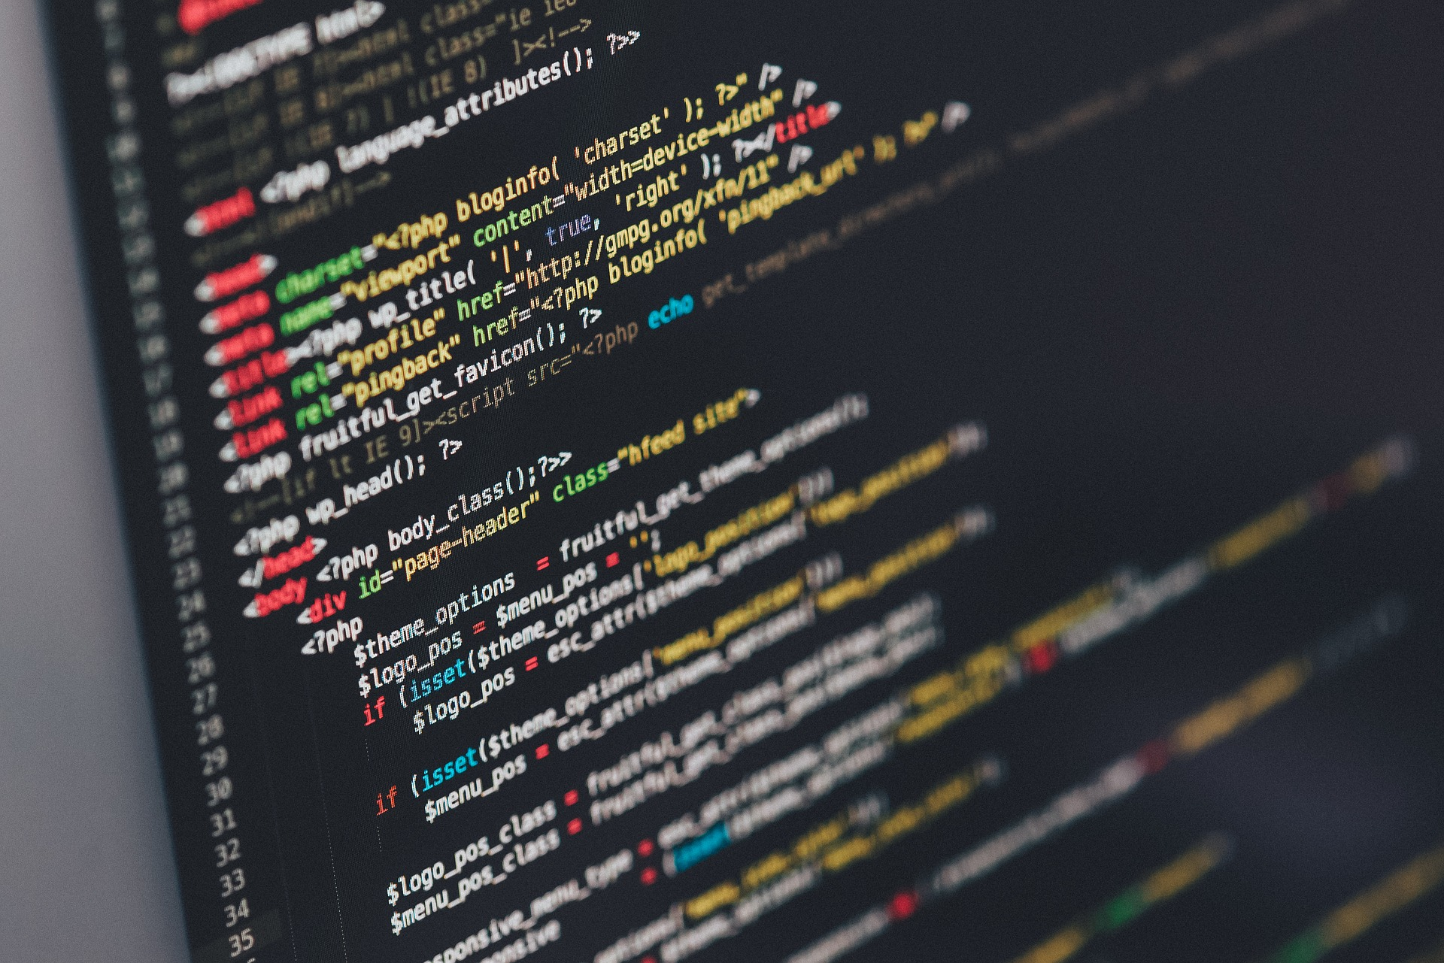
Programming in a Nutshell
Programming involves the writing of instructions as code, that orchestrate the actions of a computer and it’s hardware components.
The instructions are written with the aim of accomplishing a specific goal or completing a specific task.
Ultimately, the code we write controls a computers’ CPU, to carry out the tasks.
There are a few different ways we can “talk” to a computer…

Slide 4
Talking to a Computer
Machine code:
01001000 01100101 01101100 01101100 01101111 00100000 01000011 01001001 01010011 00110001 00110001 00110001 00110010
Assembly language:
MOV AL, 1h;
MOV CL, 2h;
MOV DL, 3h;
Natural Language:
Hi computer, please could you tell students on the visit day that coding is actually fun but also a powerful skill to learn?
01100001 01101100 01101001 01100011 01100101 00100000 01110011 01110101 01100011 01101011 01110011 00001010
Notes:
When talking to a computer, what do we mean? Well, we mean communicating to the machine in a language it understands. This is generally known as machine code. Machine code is very hard for us as humans to understand, thus we normally use what we call ”higher-level” languages to talk with machines. For instance, we could use assembly language to talk to the computer. But this must still be translated into machine code for the computer to understand.
Low-level languages such as machine code and assembly language are hard for us as humans to understand. They are too low-level. We’d rather communicate to machines using natural language if we could. Wouldn’t it be great if we could just talk to the computer, and have it do what we ask. That natural language could then be translated to machine code for a computer to understand.
Unfortunately it’s not yet possible for us to talk to a computer and control it this way. It is a very difficult problem to solve as human language is so expressive. Thus, we make a compromise. We use computer programming languages that mix low and high-level elements together, to create a programming language. Today we’ll use one such language – Python.

Slide 5

Python – a high-level language
Python is a interpreted, high-level programming language.
The Python code we write it is interpreted line by line and executed by a computer.
First we write human readable Python source code files. These end with the .py extension.
The a program know as the Python interpreter takes these files and converts them in to machine readable byte code files ending with the .pyc extension.
This output is read by the CPU so it can carry out tasks – this is what we’ll do today.

Slide 6
Why is programming important?
We live in an increasingly digitised world - from the mobile phones in our pockets, the computers we use and even home appliances (.e.g. smart fridges!).
Such technologies are only made possible through software – software that,
Controls these systems.
Allows them to interact with each other.
Allows us to interact with them.
Software is comprised of computer code written by programmers. Thus, without code and programmers, all these amazing systems would simply not exist.
The importance of software is also increasing over time.
We therefore have a choice – do we want to just be users of the software (with no control), or, do we want to help shape the software all around us….
Given that our world is becoming increasingly automated due to software, I would suggest that it’s advantageous to be skilled in software creation – it will make us more employable.

Slide 7
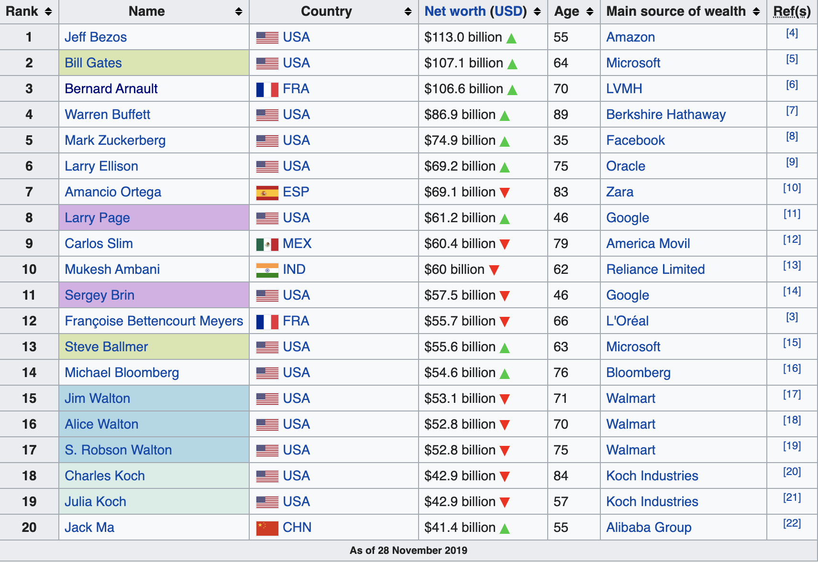
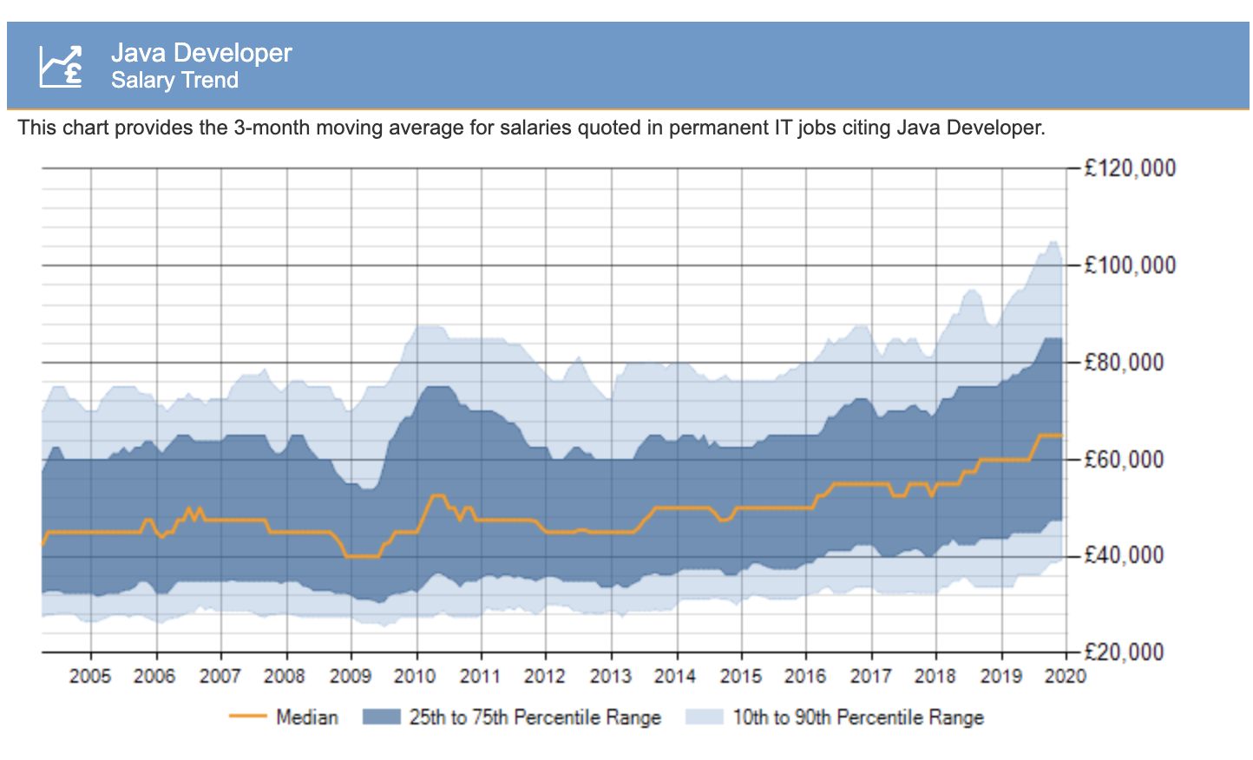
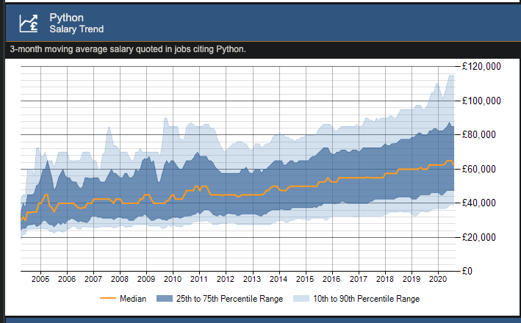
A good career path?
As of January 2020, the median salary for a Java developer is £65,000.
As of Sept. 2020, the median salary for a Python developer is £62,000.
The prospects are amazing – if you work hard.
Of the worlds 20 richest people, 8 are in software engineering.

Slide 8
Our Degree Paths
Python Programming
(everyone)
Java / Python / C# Programming
(multiple modules)
Java / Python / C# Programming
(multiple modules)
Year 1
Year 2
Year 3
Graduate
Semester 1
Semester 2
Semester 1
Semester 2
Semester 1
Semester 2
Java Programming
(everyone)
Java / C# Programming
(varies my path)
Final year project
(everyone) – often
has a programming
component
Your module choices influence the programming you do – but everyone does some!

Slide 9
Programmes needing Programming Skills!
BSc (Hons) Computer Engineering, Science, Science and Mathematics
BSc (Hons) Computing
BSc (Hons) Computing (Games Programming)
BSc (Hons) Computing (Networking, Security & Forensics)
BSc (Hons) Data Science
BSc (Hons) Robotics & Artificial Intelligence
BSc (Hons) Software Engineering
MComp Computing
BSc (Hons) Information Technology for Business
Desktop software
Algorithms
Mobile applications
Modelling
Web-applications
Games
Security software
Security testing
Data analyses
Intelligent systems
Automation
Sensors
Management
Control systems
E-Commerce

Slide 10
Review
You now know what programming is – a process that produces code that we can use to control a computer.
We know how programming relates to our degree programmes.
We know why coding is important.
Next we turn our attention to giving you the chance to write some code – we’ll first need to get access to a development environment that we can use to write / run code.

Slide 11
Coding Activities
Hopefully, you’ll find this fun and interesting!

Slide 12
Software Development Environment
To develop code we need a couple of tools.
A tool we can use to write code – a little like using Microsoft Word to write essays.
A tool that converts the code files we write, into machine code.
A tool that allows us to run the machine code.
We typically think about these tools together as a single development toolkit.
Such toolkits operate in a development environment – i.e. a software environment set up on a computer that we can use.
We don’t have the time to setup our own environments – instead, we’re going to use a pre-built, on-line development environment that allows us to write Python code.
This tool is called Google Collaboratory.

Slide 13

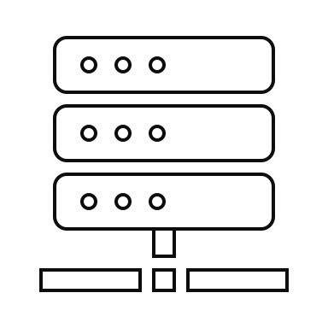

Google Collaboratory
Google Collaboratory has it’s own code editor, and tools that can be used to run code.
You connect to this via the Google Chrome web browser.
You may be interested to know that Google Collaboratory is a cloud environment.
It is also a great environment for newcomers!
Language Tools
External Libraries
Tools (Code Editors)

Slide 14
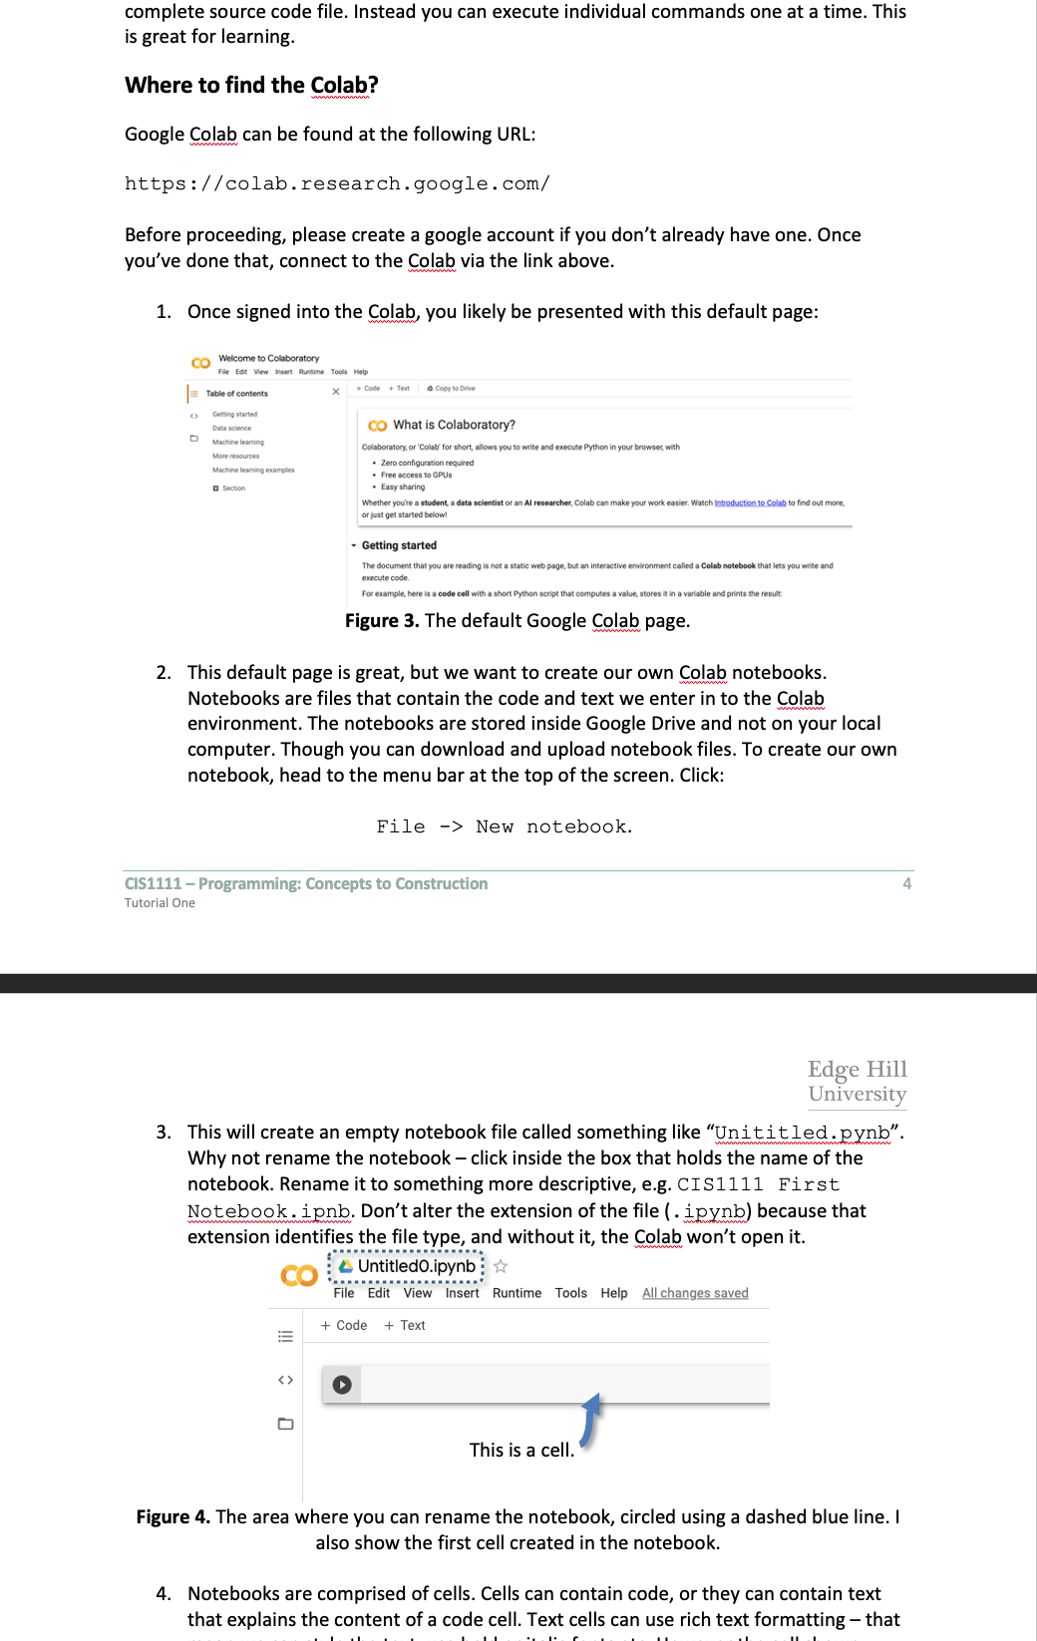
Activity 1.
Connect to the Google Collaboratory.
You need:
A google account.
The google Chrome web-browser installed.
The next slide has more details…
Instructions are in the word document provided.

Slide 15
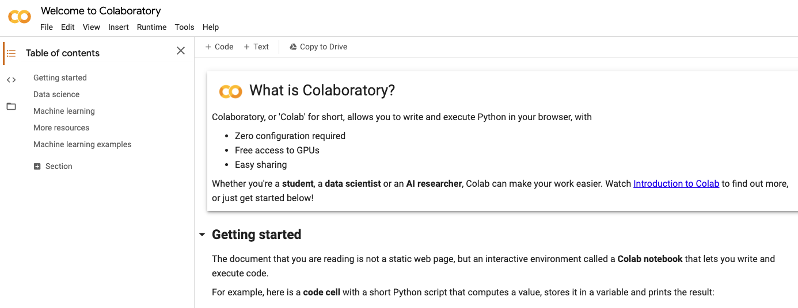
Activity 1. Accessing the Collaboratory
Firstly open google Chrome – if you don’t have Chrome, you’ll need to install it via: https://www.google.com/intl/en_uk/chrome/ .
Create a Google account if you don’t have one, then sign-in to the Collaboratory environment via: https://colab.research.google.com/ .
Once everyone is signed in, you should see a user interface that looks a little like this:
When everyone is ready, let me know.
Notes:
Google Chrome install link: https://www.google.com/intl/en_uk/chrome/
Google Collaboratory link: https://colab.research.google.com/notebooks/intro.ipynb

Slide 16
Activity 2.
Creating your own notebook.
You need:
The instructions document to guide you, just in case you get stuck.
Instructions are in the word document provided.

Slide 17
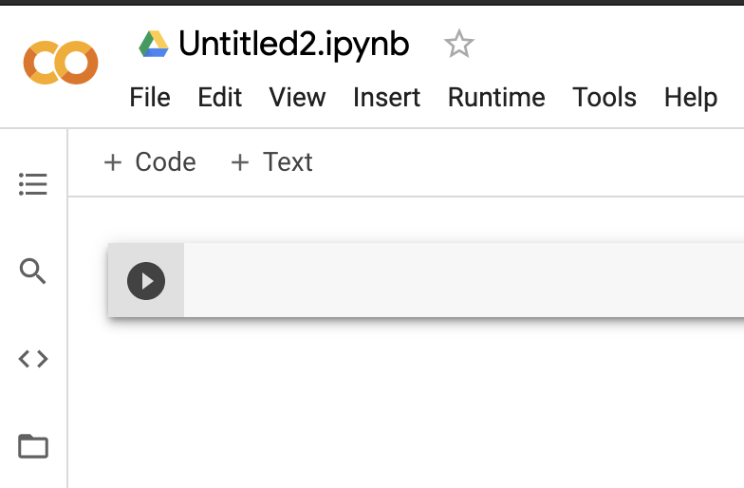
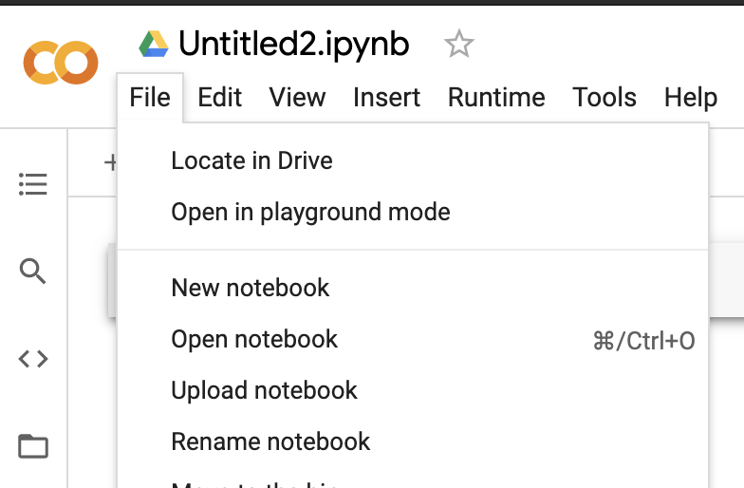
Activity 2. Creating a notebook
A notebook is a coding environment within the Collaboratory.
It’s actually a special environment, because it allows you to write code or normal text within it.
The notebook itself is represented within a single file – stored in the cloud (in Google Drive).
Notebook files end with the .ipynb file extension.
Next, I want you to create your own “notebook”.
Click the File menu at the top of the Collaboratory interface.
Select the New Notebook option.
Let me know when you’ve done this.
Creating a new notebook – click File -> New Notebook.
Notes:
Google Chrome install link: https://www.google.com/intl/en_uk/chrome/
Google Collaboratory link: https://colab.research.google.com/notebooks/intro.ipynb

Slide 18
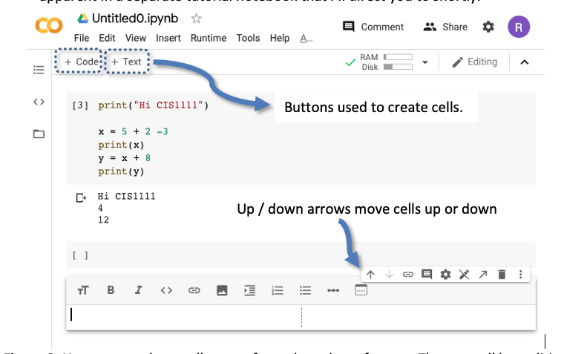
Demo 1.
Showing you around….
Sit back and watch as I talk you through the following concepts in the Google Collaboratory:
A cell – a place where you can write code / text.
How to “run” a cell and what that means.
How to write code in a cell.
Remember: Instructions are in the word document provided.

Slide 19
What we’ve seen…
We’ve now seen what a text cell is – how it can be used to provide information that helps explain our code.
We’ve also seen a code cell and learned how to run it using the “play” button.
We’ve also learned how we can delete cells, move them up or down, and how the environment is structured in general.
Next, we get you working in this environment.
To do that, we ask you to first load a notebook I made earlier….

Slide 20
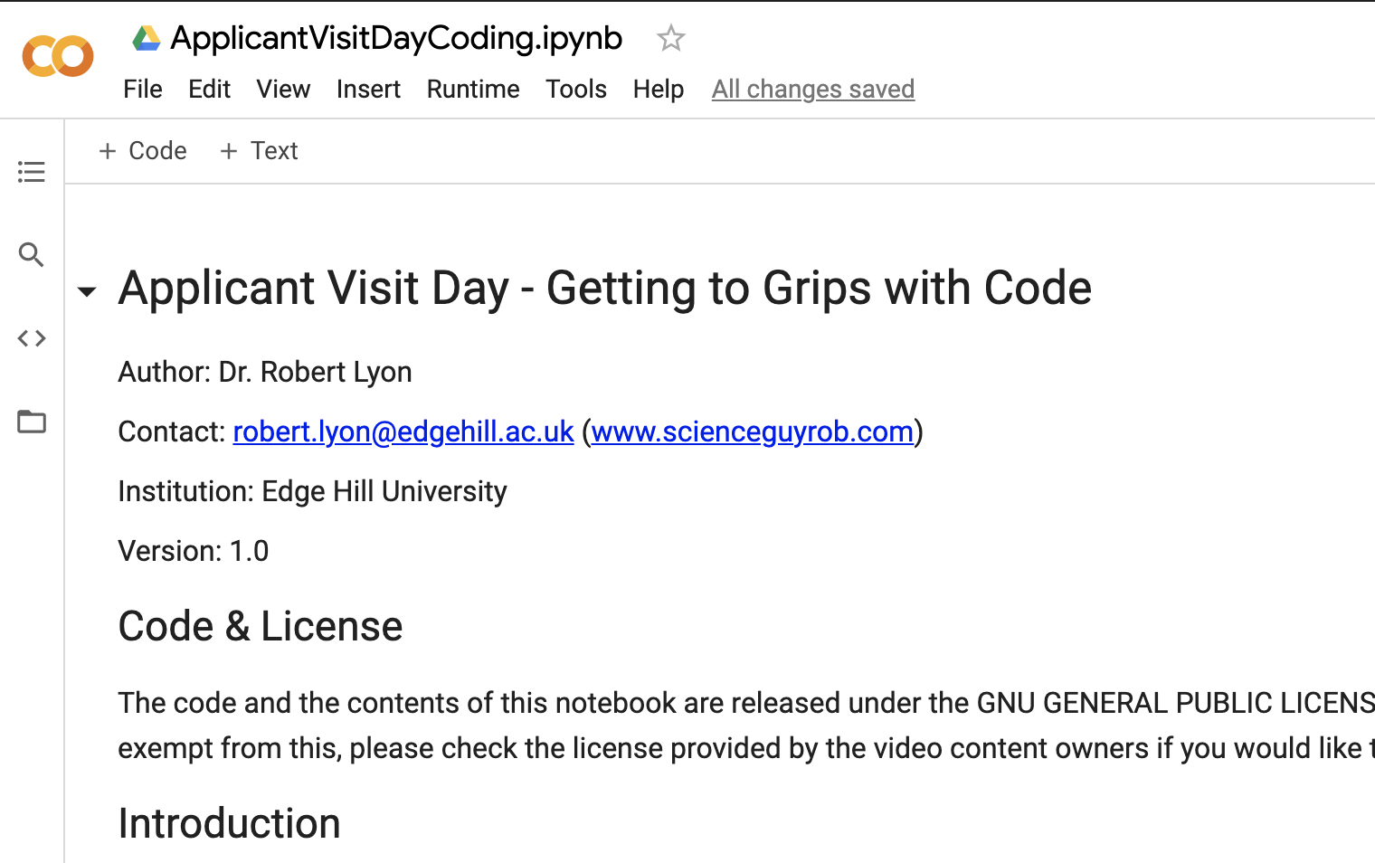
Activity 3.
Loading the activity notebook.
You need:
The notebook file: ApplicantVisitDay.ipynb to be downloaded somewhere on your computer (e.g., your downloads folder).
This file can be found in the Blackboard environment you’re using.
The notebook we’re going to load.
Notes:
Activities files also available in Github at: https://github.com/yannisKork/ProgrammingTasterEHU

Slide 21
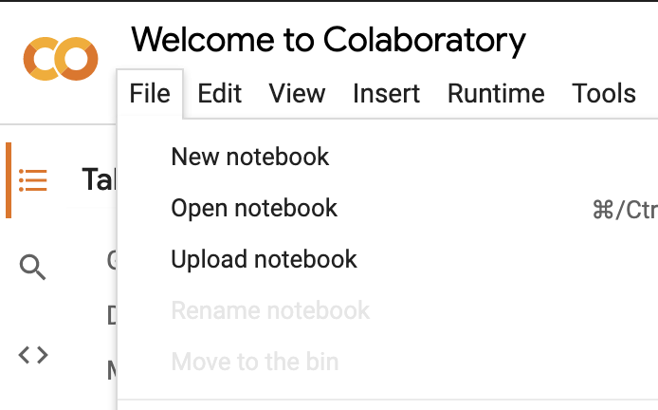
Activity 3. Loading the notebook
Download ApplicantVisitDay.ipynb to some location on your personal computer. For instance, download it to your downloads folder.
Head to the Collaboratory environment.
Click the File menu at the top of the Collaboratory interface.
Select the Open Notebook option.
A file chooser dialog will open that allows you to choose a file to upload. Please upload the ApplicantVisit.ipynb file you saved to your computer in Step 1.
Let me know when you’ve done this.
Creating a new notebook – click File -> Open Notebook.
Notes:
Google Chrome install link: https://www.google.com/intl/en_uk/chrome/
Google Collaboratory link: https://colab.research.google.com/notebooks/intro.ipynb

Slide 22
Next steps
You should have loaded the ApplicantVisitDay.ipynb notebook successfully.
The notebook itself contains instructions on what to do next – there are also some coding challenges and some learning material.
It’s your job to read through this, with my support, and to solve the challenges.
We’ll give you some time to do this, just like we would in class during a real lesson.
Then with around 10 minutes to go, we’ll come back together to finish up, and give you the opportunity to ask questions.
So on your marks, get set…. GO!

Slide 23

Activity 4.
Tackling the notebook.
You need:
To try and tackle the notebook activities for yourself – I’m here to help you and answer questions.
If you’ve coded before and want a challenge… then let me know!
How fast can you get through the material :P

Slide 24
Reflecting on today
You may not realise but today you’ve done the following:
Used an industry standard software environment for writing Python code – it is especially used in Data Science and for Machine Learning research.
Learned how to run code in this environment.
Learned how to write some basic Python statements in the Collaboratory environment.
Learned why coding is so important and how it elates to your (potential) degree programme.
Not bad for an hour? Maybe if you join us, you’ll learn a whole lot more!

Slide 25
Follow-up Learning
No matter where you decide to study, getting ahead start is beneficial.
Here are some resources you can use to help prepare you and build your programming knowledge:
A free eBook called “Think Python”, by A. Downey, 2nd Edition, Green Tea Press.
Code academy – free programming tutorials available online: https://www.codecademy.com/
The Solo Learn mobile application: https://www.sololearn.com/

Slide 26
Learning Aims
By the end of this session I want you to understand / be aware of:
The basic principles computer programming – how we write code.
Why we write code (to control a CPU) and what that gives us.
How coding is used throughout our degree programmes.
How coding is beneficial to you and your career / employability.
A tool used to write code – Google Collaboratory.
How to write some basic computer programs in the Python programming language.

Slide 27
Applicant visit day – DONE.
Find out more details about our department on-line.
I hope you enjoyed today and now understand what it might be like to study with us!
Do you have any questions?

